Slide 1





Exploring a Feasible Platform for Project Management
1
Group ID: RP24_002

Slide 2

1
Group ID: RP24_002

Slide 3


TEAM MEMBERS
Pabasara J.D
IT21073014
De Silva D.S.P.K.D
IT21034954
Sandeepani J.W.H
IT21049040
Fernando R.D.S.A
IT21011948
3
Group ID: RP24_002

Slide 4


SUPERVISORS
Supervisor
Dr. Anuradha Jayakody
Co - Supervisor
Mrs. Buddhima Atthanayaka
Group ID: RP24_002
4

Slide 5


INTRODUCTION
What is PM Pulse?
  PM Pulse is an innovative project management tool designed to enhance project management efficiency by offering advanced features like risk detection, skill-based employee KPI generation, dynamic project navigation, and time forecasting.
Why PM Pulse is Important?
  PM Pulse is crucial for project managers as it empowers them with advanced tools for proactive risk management and real-time project insights, ensuring that projects are delivered on time and aligned with organizational goals
5
Group ID: RP24_002

Slide 6

RESEARCH PROBLEM
  Why is an integrated platform necessary for effective project management?
  How does integrating advanced features like risk detection, skill-based KPI generation, and risk-adjusted time forecasting in impact project management efficiency and project delivery timelines?
  What is the effectiveness in empowering project managers with proactive risk management and real-time insights, and how does this influence alignment with organizational goals?
6
Group ID: RP24_002

Slide 7



MAIN OBJECTIVES
Objective 01
Objective 02
Objective 03
Enhance Project Management Efficiency
Automatically team formation
Proactive Risk Management
7
Group ID: RP24_002

Slide 8
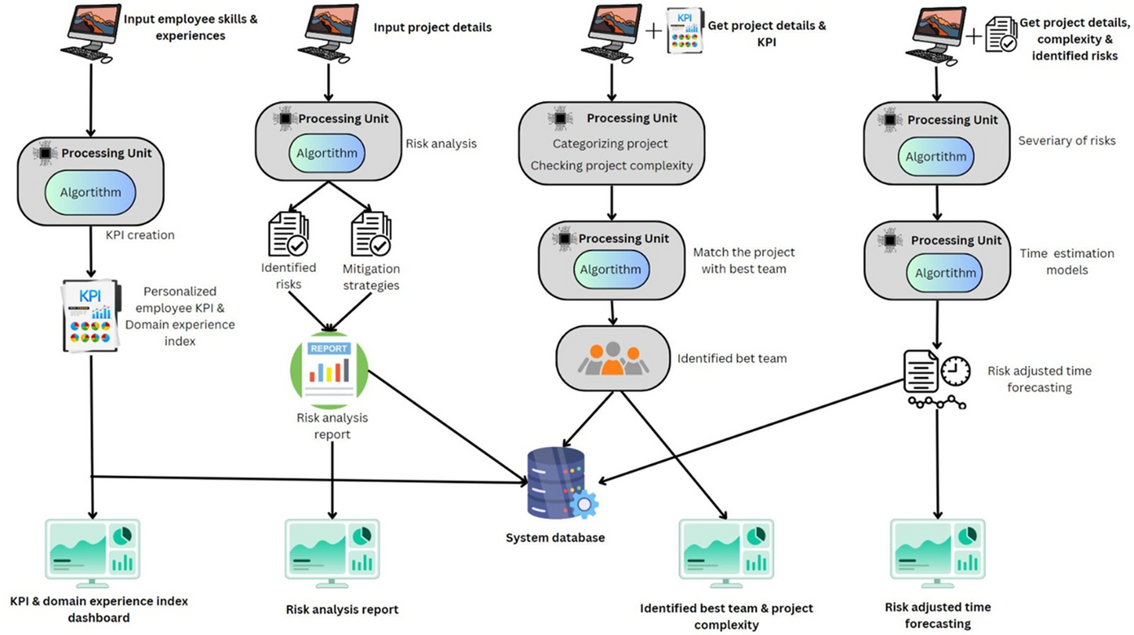
SOLUTION ARCHITECTURE
  Skill-based Employee KPI Generator
  Risk Identification And mitigation
  Dynamic Project Navigator
  Time Forecasting with SDLC analysis
8
Group ID: RP24_002

Slide 9
SKILL-BASED EMPLOYEE KPI GENERATOR
  Automated systems generate team-specific, skills-based KPIs to monitor employee productivity and contribution, enabling precise tracking of performance tailored to experience and role.
  Analyze various skills and experience required for different roles
  Create a user-friendly interface for entering employee details
  Generate customized KPI metrics and targets for each employee.
  A separate weighted scoring table is created for each job role and a formula is created for it.
9
Group ID: RP24_002

Slide 10

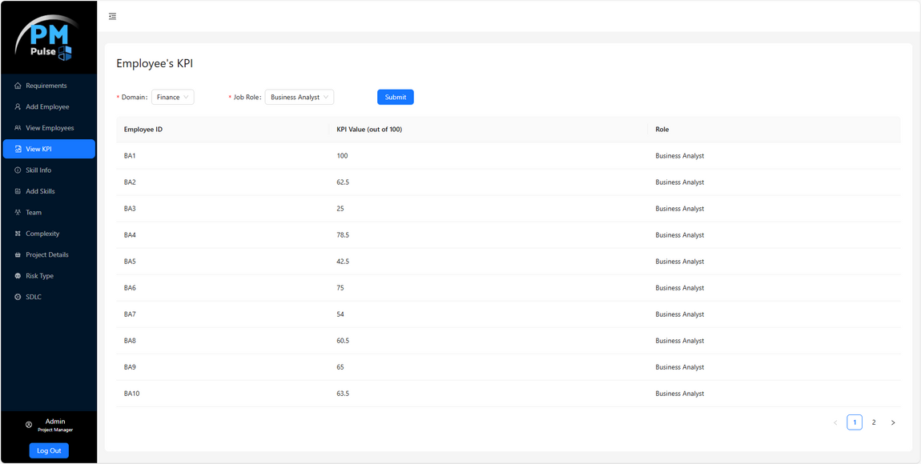
RESULTS
  Backend completed
  Data Gathering & Dataset Creation
  API Testing
  Frontend Implementation
  Web App Integration API Testing
10
Group ID: RP24_002

Slide 11
RISK IDENTIFICATION AND MITIGATION
  After new projects are added, an XGBoost model assesses risk levels (Low, Medium, High) based on project characteristics, while a large language model identifies specific risks and provides targeted mitigation strategies.
  Accurately predict the risk level for each software project using a machine learning model
  Develop a user-friendly interface that presents risk reports and suggested mitigation strategies.
  Provide AI-driven mitigation strategies (using GPT4o model) to address identified risks and minimize their impact on project execution.
11
Group ID: RP24_002

Slide 12
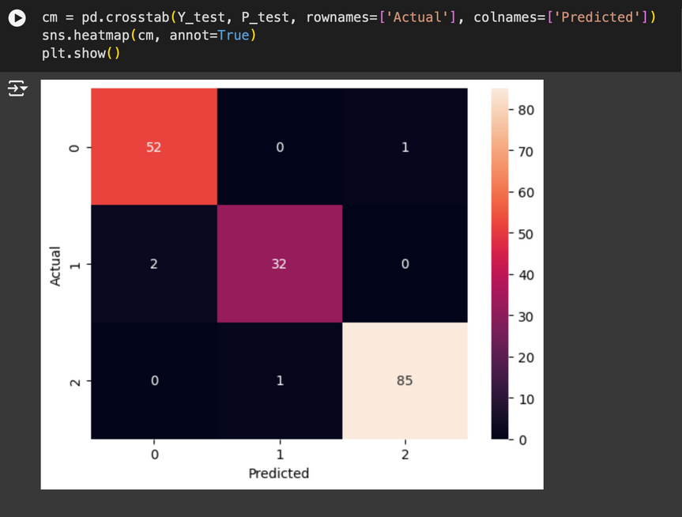
RESULTS
  Backend completed
  Data Set Gather From Kaggle
  API Testing
  Optimizing the created models
  Frontend Implementation
  Web App Integration API Testing
The XGBoost Classifier predicts project risk levels with 97.7% accuracy, correctly identifying most low, medium, and high-risk projects. The model shows strong performance with minimal misclassifications, ensuring reliable risk assessment for software projects.
12
Group ID: RP24_002

Slide 13
DYNAMIC PROJECT NAVIGATOR
  This component aims to project categorization based on properties like type, scope, domain. It will map projects to key performance indicators and also the best team assign the automatically.
  Automated Team Formation and Project Complexity Categorization are the main goals in this component.
  Team Formation Algorithm,Random Forest Model Training are the methodologies that used in here.
13
Group ID: RP24_002

Slide 14
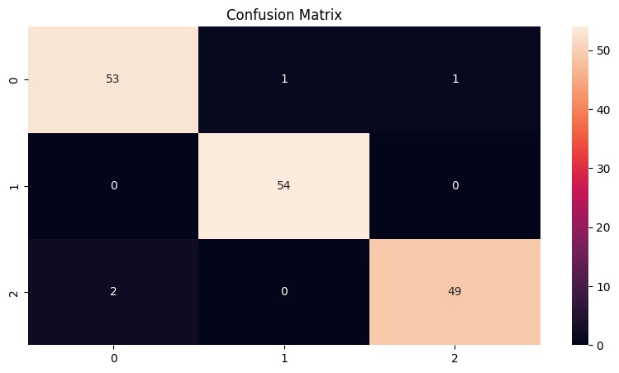
RESULTS
  Backend completed
  Data Gathering & Dataset Creation
  API Testing
  Optimizing the created data models
  Frontend Implementation
  Web App Integration API Testing
Confusion Matrix - Visual Representation of the Model
14
Group ID: RP24_002

Slide 15
TIME FORECASTING WITH SDLC ANALYSIS
  Developed with machine learning and risk management, provides accurate SDLC-based time estimates for complex projects, enhancing planning and decision-making across E-commerce, Health, and Education sectors.
  Calculate project time duration using machine learning techniques..
  Provide actionable insights for project managers to enhance decision-making, planning, and resource allocation.
  Provides risk mitigation adjusted results results.
15
Group ID: RP24_002

Slide 16
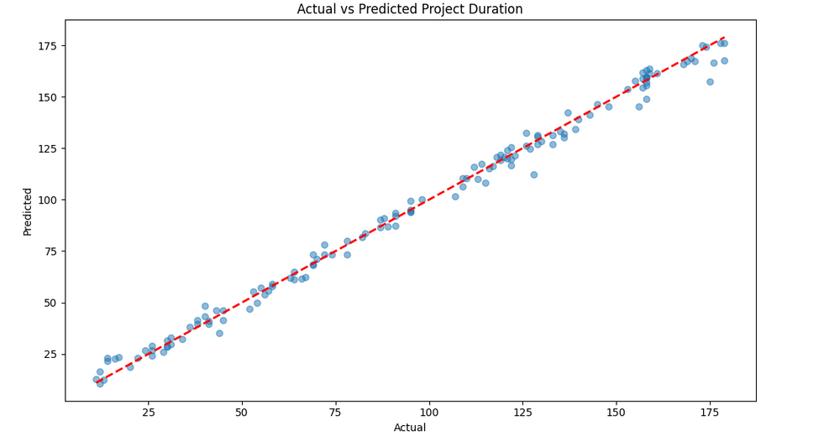
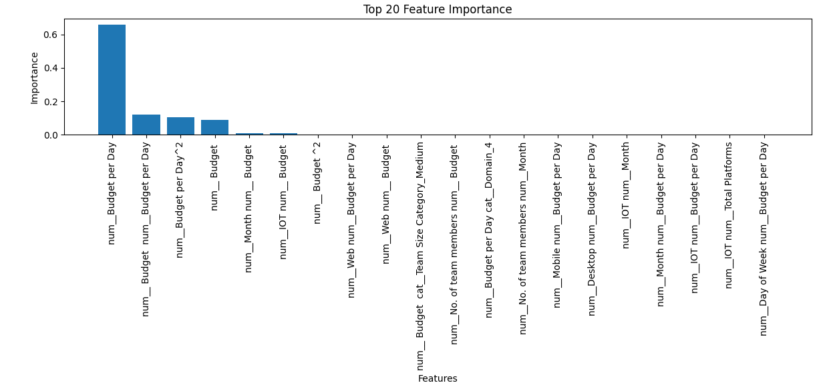
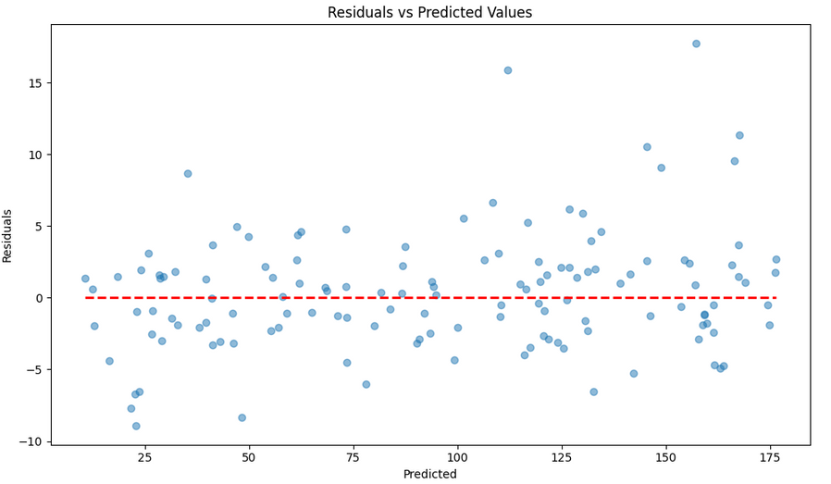
RESULTS
•Backend completed in Time duration prediction.
•Frontend for time duration prediction.
16
Group ID: RP24_002

Slide 17

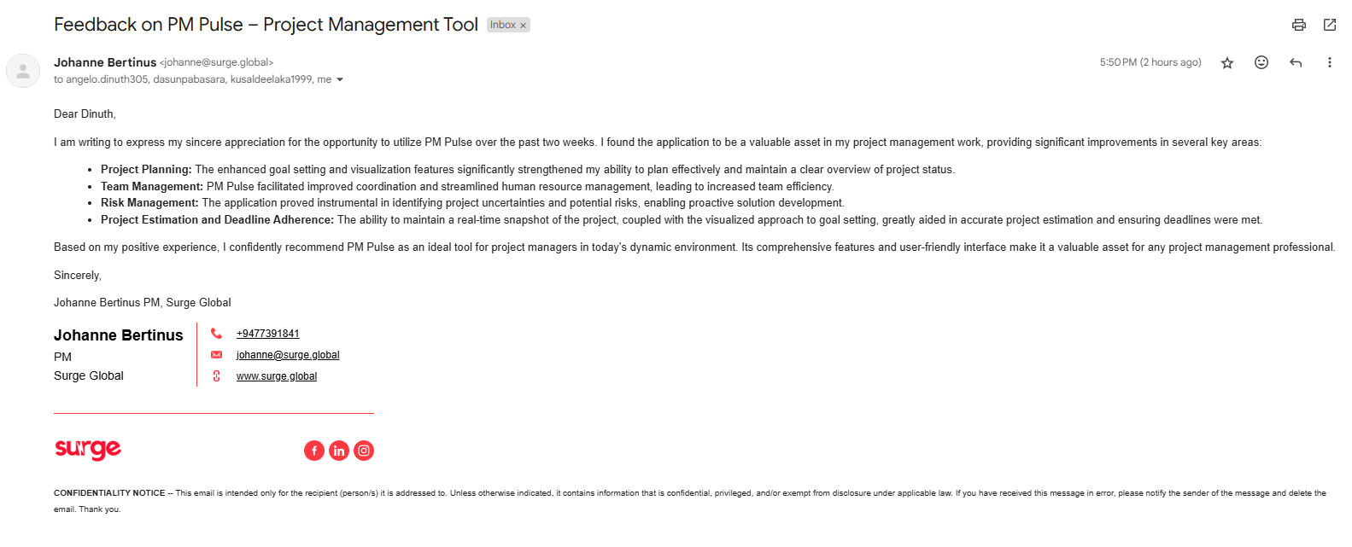
USER ACCEPTANCE TESTING FEEDBACK
17
Group ID: RP24_002

Slide 18
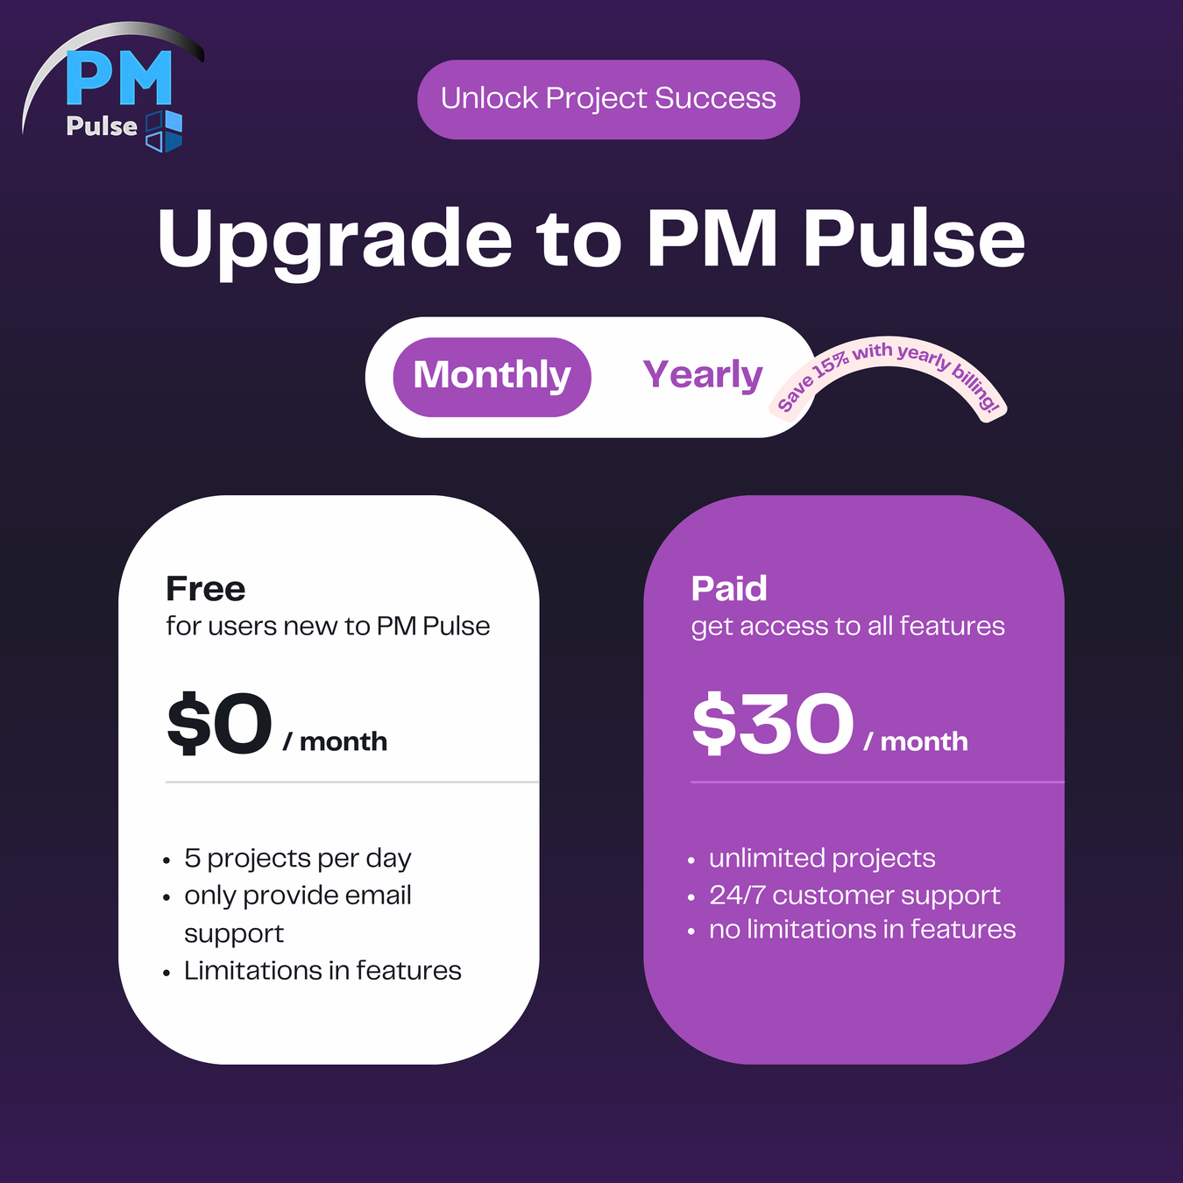
BRANDING
18
Group ID: RP24_002

Slide 19
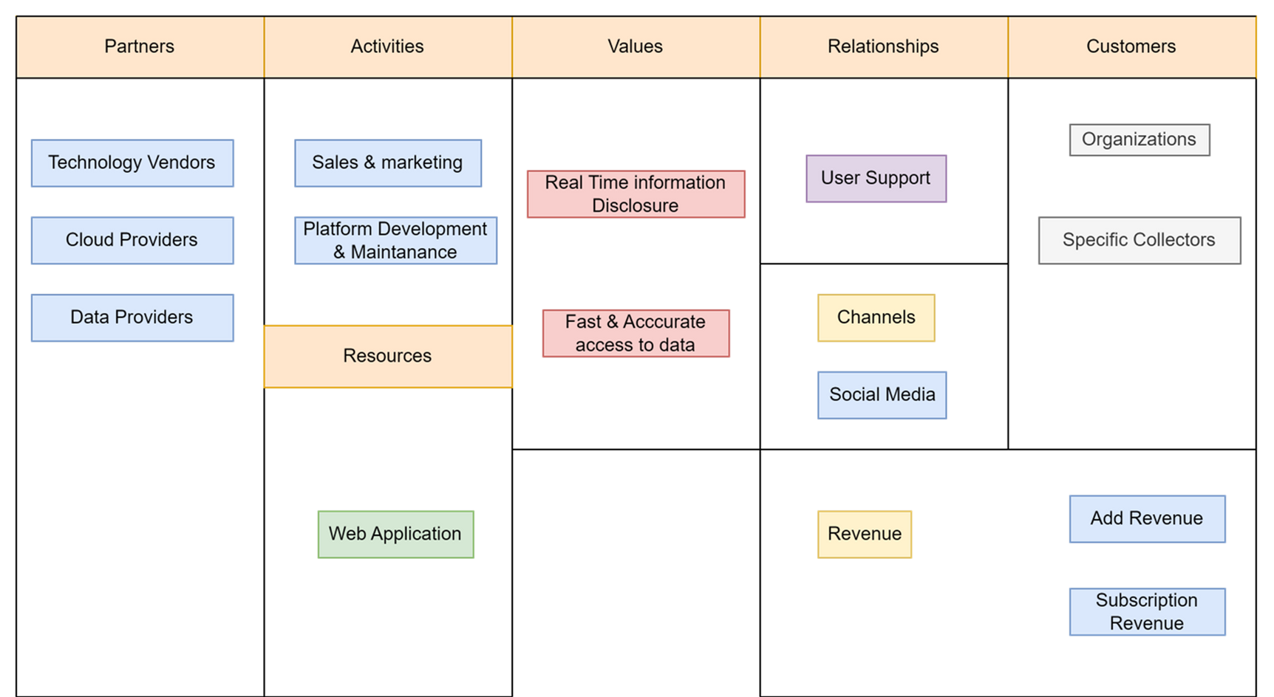
BUSINESS PLAN
19
Group ID: RP24_002

Slide 20

THANK YOU !
20
Group ID: RP24_002

